Slide 1
The security guide to the internet
Minigames

Slide 2
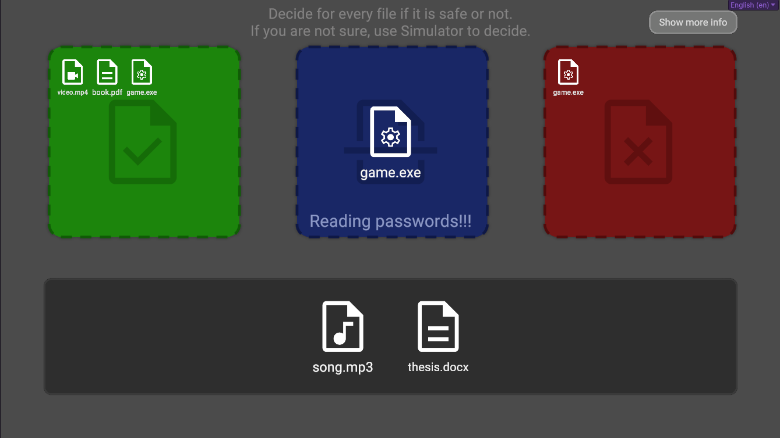

Slide 3
1.1.1.1
2.2.1.1
10.18.1.1
8.8.8.8
1.1.1.1
8.8.8.8
2.2.1.1
10.18.1.1

Slide 4




name
submit
www.original-website.com
match
90%
email
reset
match
00%
username
password
username
login
submit
password
register
www.phishing-website.com?original-website.com

Slide 5








Session id
Theme
Visitor Count
Ad Targeting
Referrer
Social Media
Cart id
Font Size
Session Recording
Affiliate Tracking
Consents
Currency
Preferences
Behavioral Analysis
Necessary
Time Zone
Language
Analytics

Slide 6




Fill password

Slide 7



Welcome
Daniel
Nicole
Oliver
Emma
Sophia
Isabella
Lucas
Evelyn
Jacob
Michael
Daniel
Matthew
Lily

